Slide 1
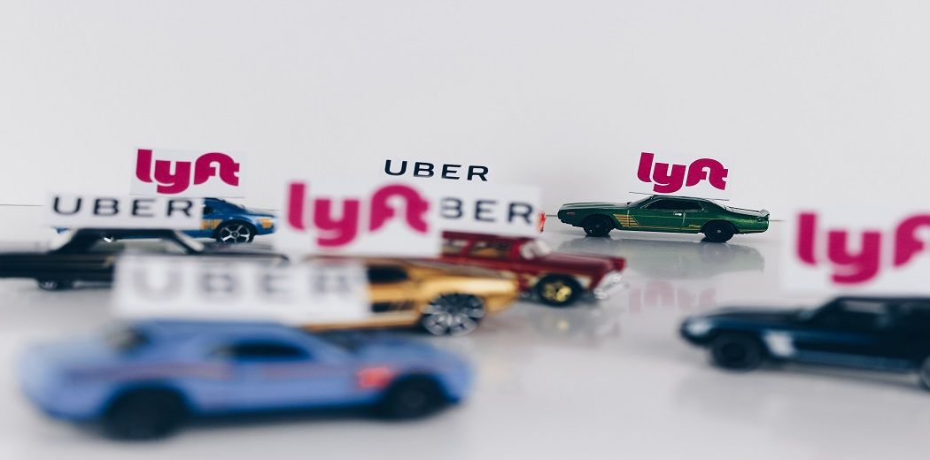
GOVERNMENT COLLEGE OF ENGINEERING, KEONJHAR
UBER DATA ANALYSIS

Slide 2

Department of Computer Science and Engineering
PROJECT PARTNER :
Abinash Jena (1921104019)
Ashutosh Malla (1921104021)
Mohit Samal (1801104139)
Soumya prajna Behera (1921104032)
Guided By :
Mrs. Sasmita Pani

Slide 3
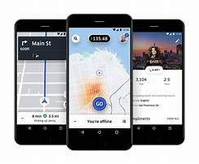
Contents :
Objectives of the Uber Data Analysis
What is Uber data analysis ?
Why data is important for Uber ?
Feasibility study of Uber data Analysis
Requirement analysis
Technologies Used
Errors and bugs identified and it’s solutions
Implementation of Project
Conclusion
Reference
Future Scope

Slide 4

OBJECTIVES :
The process of data analysis uses analytical and logical reasoning to gain information from the data.
The main purpose of Uber data analysis is to find meaning in data so that the derived knowledge can be used to make informed decisions

Slide 5
What is UBER Data Analysis :
Uber uses your personal data in an anonymized and aggregated from to closely monitor which features of the service are used most.
To analyze usage patterns and to determine where we should offer or focus our services.
Why Data is Important For UBER ?
Uber stores and analyses data on every single trips the users take which is leveraged to predict the demand of cars, set the fares and allocate sufficient resources.
Uber team use Uber data to calculate driver incentive payments and predicts many other real time events.

Slide 6
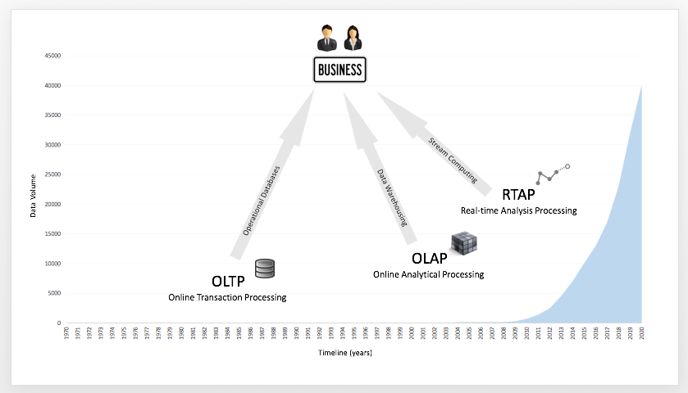
Literature review
Existing System :
Online Transaction Processing (OLTP)
Online Analytical Processing (OLAP)
Proposed System :
Real Time Analysis processing (RTAP)

Slide 7
Market Feasibility
Feasibility study
Of
Uber Data Analysis
Financial
Feasibility
Operational Feasibility
Technical Feasibility

Slide 8
Market Feasibility :
Uber is part of the taxi industry. The industry has traditionally been managed by federal and state regulated licensing. The taxi industry is largest in urban areas or cities that include a high immigrant population or a history of mass immigration. The taxi industry is developed specifically for transportation of people from one location to another. The largest advantage that Uber has over any taxi service is the ability to meet supply and demand based on their mobile app. The incredible number of drivers allows Uber to deliver quickly and effectively based on a heat map which displays the most demanding locations.
By analyzing uber trips, we can draw many patterns like which day has the highest and the lowest trips or the busiest hour for uber and many other patterns
From these it is clear that the project is Market Feasible

Slide 9
Operational Feasibility :
This approach to expand Uber’s brand will allow the company to develop a stable foothold for legalities while also making sure the business is expanding into larger circles by partnering with potentially successful markets.
The project Uber Data Analysis used different tools to identify relevant data from the given data set by using different technologies.
From these it is clear that the project is operationally Feasible

Slide 10
Technical Feasibility :
The Project Uber Data Analysis is complete Data Analysis Project.
The main technologies that are associated with Uber data Analysis are
Python Machine Learning Scripting Language
• Numpy
• Pandas
• Matplotlib
• Google Colab
Each of the technologies are freely available and the technical skills are manageable
From these it is clear that the project is Technically Feasible

Slide 11
Financial feasibility :
Being a Data analysis project it will not have associated with any types of cost
The system will follows the freeware software standards. No cost will be charge from the potential customer.
And there is no maintenance cost also.
From these it is clear that the project is Financial Feasible

Slide 12
Requirement Analysis :
Hardware
• Core I3 processor or higher
• 256 MB RAM or more
• 700 MB HDD or more
Software
Any Operating System
Windows 10 or more
Jupyter Notebook

Slide 13
Technologies Used
Tool Used
A computer system running on Windows.
VS Code was installed for editing all the Python codes.
Jupyter Notebook was installed in VS Code.
Languages Used
Python
Numpy
Pandas
Matplotlib
Seaborn

Slide 14
Errors and bugs identified and it’s solutions
1.Cant load the csv file using panda in virtual studio code Warning:unable to open Uberdrive.csv
Solution-first we were importing it from internet directly.Then after the error we download the data set and give the complete path of the data set
2. During calculation of total number of unique start destination ,we use a predefine function count()
Warning:attribute error,set object has no attribute count
Solution-Count() cant be used in set so we use len()

Slide 15
3. Whenever we open vs code and continue our work from where we end last time code doesn’t run
NameError: name 'uber_df' is not defined
Solution-every time you open editor to continue work you have to first run the 1st code cell where you import module and read the data frame
4. When I convert the date and time in format of HOUR,DAY,MONTH,WEEK DAY
code gives
ValueError: time data '01-01-2016 21:11' does not match format '%m/%d/%Y %H:%M' (match)
Solution- first we have to change the data of STARTDATE ,ENDDATE in the format of %m-%d-%Y in Excel then run it.

Slide 16
Implementation of Project
Installation of Virtual studio code was done.
Installation of Python was done.
All the modules required for project like PANDA,NUMPY,MATPLOTLIB were installed.
Installation of Jupyter notebook was done in vs code.
Collection of data set of uber was done.
Cleaning of the data set was done.
Then we annalyse the data by various objective.

Slide 17
Conclusion :
At the end of this Uber data analysis project. We will study how to create data visualization.
With this we can conclude that how time and place affects customer trips.

Slide 18
References
[1]Wes McKinney,”Python for data analysis 1st eddition”,pp.9-342012
[2] Wes McKinney,”Python for data analysis 2nd eddition”,pp.67-83,2017
[3] Mrunal Patil1, Vidya Kumari, Adarsh Patil, Laxmikant Ahire and Asst.Prof. Umakant Mandawkar ,” UBER DATA ANALYSIS USING GGPLOT” Dept. Computer Science and Engineering, Sandip University, Nashik, July 2012
[4]https://www.skyfilabs.com/project-ideas/uber-data-analysis
[5]https://www.uber.com/us/en/careers/teams/data-science/
[6]https://iedu.us/tag/project-in-r-uber-data-
analysis-project/
[7]https://colab.research.google.com/drive/1igWmyXur60I_etxsf6N7jV8PTbQou5B U?usp=sharing
[8] https://github.com/zaidjamal-op/UBER-data-analysis-machine-learning
/blob/main/Uber%20data%20analysis/UBER%20Data%20analysis.ipynb
[9] https://coursera.org/learn/data-analysis-with-python

Slide 19
Future Scope
We can use this data for training a model using ML and building a smart AI based predictive system.
Model can automatically send the insights to the authorities or drivers related to areas having most trips and passengers count in certain areas.
The big data can be used to study passenger’s behavior.

